Slide 1
DATA STRUCTURES LABORATORY
Lab Session 10 (linked list)

Slide 2
Session No. | Programs | Page No.
1 | To find the length of a string To concatenate two strings To copy a string to another string To reverse a string
2 | To generate “n” terms of the Fibonacci series To find the GCD of two numbers
3 | To insert an element at a given position in an array To delete an element from a given position in an array To perform Bubble sort
4 | To perform Insertion sort To perform Selection sort
5 | To perform Linear search To perform Binary search
6 | To perform stack operations
7 | To perform Queue operations
8 | To perform circular Queue operations
9 | To convert Infix expression to Postfix expression
10 | Insertion of elements to a linked list
11 | Deletion of elements from a linked list
12 | To create a binary tree and perform tree traversal

Slide 3
Insertion of elements to a linked list
A linked list consists of a data element known as a node. And each node consists of two fields: one field has data, and in the second field, the node has an address that keeps a reference to the next node.
A linked list is a linear data structure that stores a collection of data elements dynamically.
Nodes represent those data elements, and links or pointers connect each node.
Each node consists of two fields, the information stored in a linked list and a pointer that stores the address of its next node.
The last node contains null in its second field because it will point to no node.
A linked list can grow and shrink its size, as per the requirement.
It does not waste memory space.

Slide 4
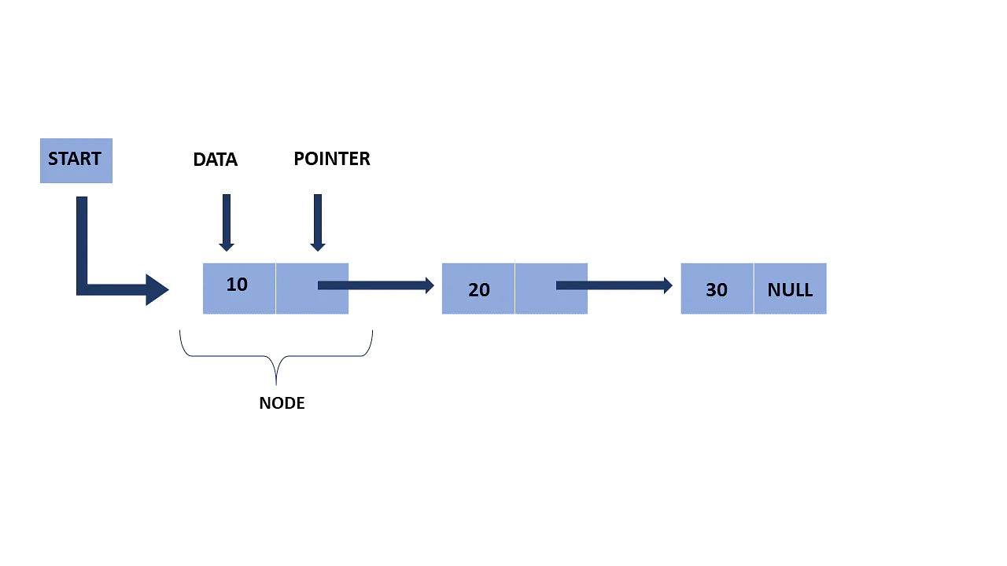
Representation of a Linked List

Slide 5
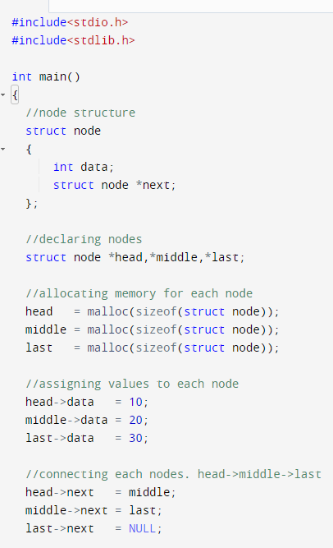
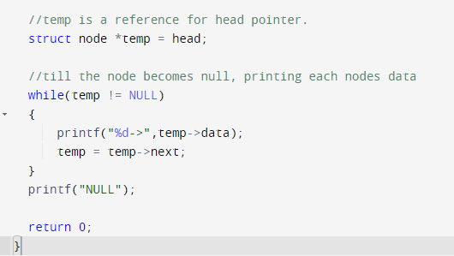
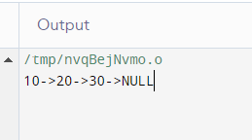

Slide 6
Deletion of elements from a linked list

Slide 7
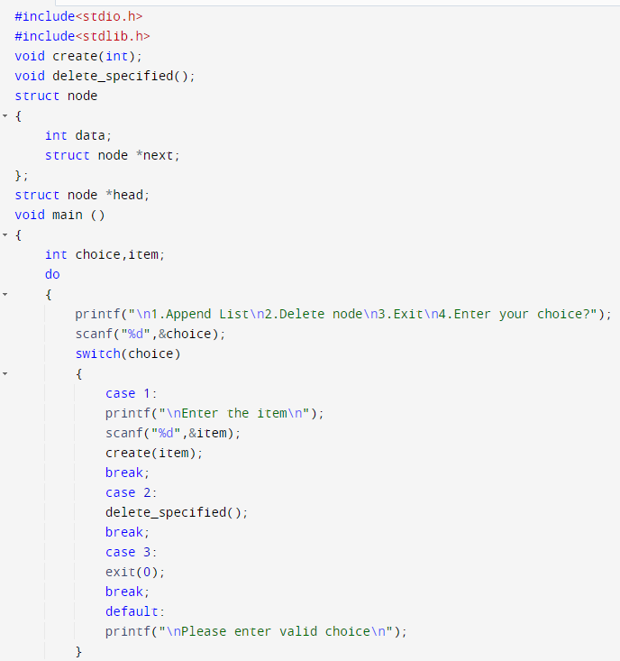
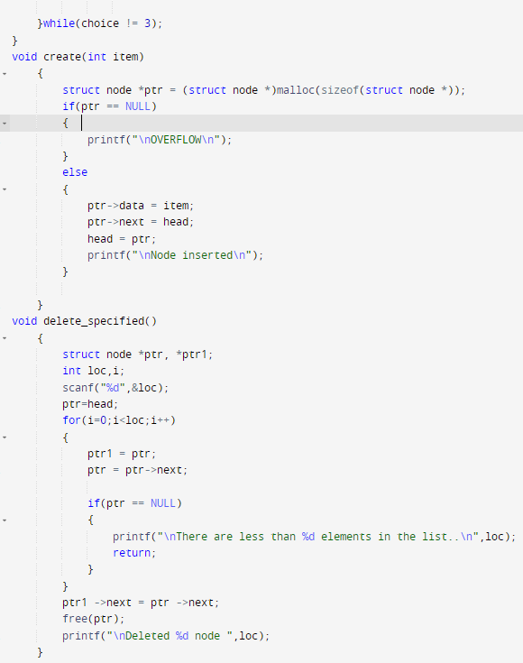

Slide 8
